Slide 1
Iota State Educational Foundation (ISEF) Grants
Our Mission Statement
Who can apply?
Potential Projects
The Iota State Educational Foundation encourages educational excellence in the Commonwealth of Virginia by promoting and supporting special projects related to the education and the development of learning and literacy for all ages.
All educators, members and non-members, may apply.
The next deadline: November 1, 2023
All projects must be consistent with the ISEF mission statement.
Awards will not be granted for salaries, overhead costs, travel expenses, courses or conferences.

Slide 2
Presenting ISEF Grant Winners!
Join the growing list of recipients!
Apply now!
Story Walk
Reading to Learn: Building Vocabulary and Content Knowledge Through Text
Band at Bird High School
Brain Pop & Color Printer for ESL
STEAM Day for Virginia Academy Middle School
Teaching Phonological Awareness through the Science of Reading
Decodable Library
Book Vending Machine
Hydroponics for Kids and Community
Learning about Famous Mathematicians
Disasters! Books to Spark Reading
We Are Writers: Using Notebooks To Encourage Student Writing Outside Of The Regular Classroom
Genius Hour

Slide 3
Highlights
Phonological Awareness
Genius Hour
“Teaching Phonological Awareness Through the Science of Reading.”
Necessary materials were purchased to support the use of phonemic awareness and phonics instruction for Boyd’s students who are still in the beginning stages of learning to read in her collaborative classroom. .
Samantha Boyd, 2nd grade teacher
Cluster Springs Elementary, South Boston, VA
Funds were received for this 90 minute weekly program designed to provide students, many who have families with limited funds, to experience a wide variety of activities from cooking to sports and even theater.
Hanna Brown, Library Media Specialist, Wenonah Elementary, Waynesboro, VA
Brain icons created by Smashicons – Flaticon.com
Photos: Microsoft Bing Library

Slide 4
Highlights
Shenandoah Decodable Library
Hydroponic
Gardening
Six sets of reading series 1 books from Flyleaf Publishing to include 10 titles were purchased for 1st grade teachers to utilize during small group reading instruction.
Shenandoah ES First Grade teachers & Instructional Coach, Shenandoah Elementary, Page County
5th grade students
learned about and shared hydroponic gardening techniques using literature and hands on materials.
Crystal McArtan (Gamma Sigma) 5th grade teacher, Flat Rock Elementary
Photo: Public Domain Library
Photo:Microsoft Bing Library

Slide 5
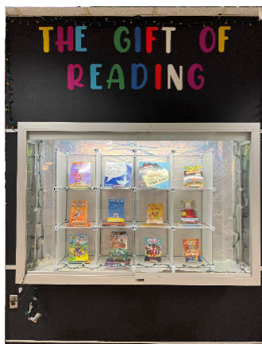
Highlights
Book VendingMachine
Famous Mathematician Library
Powhatan Elementary School converted a showcase into a book vending machine. The grant was used to purchase books for the machine.
Michelle Ball (Gamma Sigma) ES Media Specialist, Powhatan School
Funds were granted to purchase a library of books about the lives and accomplishments of famous mathematicians.
Allie Stough (Beta Pi) Exceptional Education Teacher, Henrico County

Slide 6
Highlights
Disaster Books to Spark Reading
We Are Writers!
The grant was used for students in grade 2-5 to recognize themselves as writers. Funding provided notebooks such as the ones writers typically use instead of the blank composition books that are normally used during the school
Dr. Jennifer Floyd (Kappa) Reading Specialist, Mountain View Elementary School, Rockbridge Co.
y
Funds were used to purchase 12 sets of Disaster! A Who HQ Collection books to inspire and spark reading interest for students with disabilities.
Neila Span & Karola Scarce (Alpha Mu) T. Clay Wood Elementary, Prince William Co.
Photo: Microsoft Bing Library

Slide 7
For questions or support
For questions or support, please contact
Dr. LeAnn Davis, ISEF chair: editorleann@gmail.com
Share the information about the grant with colleagues with the ISEF flyer available online, front page of va-state.org, official website of the Virginia State Organization of DKG (Delta Kappa Gamma)
We are looking for your application soon!

